Slide 1

UNIVERSITI TEKNOLOGI MALAYSIA
Research Design and Analysis in Data Science MCST1043
Predictive Maintenance and Performance Optimization for Jet Engines Based on Rolls-Royce Engine Manufacturer and Services Within the Aerospace Sector
Done by: Siti Syahirah Binti Mohd Yunus (MCS241012)
Prepared for: Prof. Madya.Ts.Dr. Mohd Shahizan bin Othman

Slide 2

OUTLINES
1
Introduction
4
Initial Results
2
Literature Review
5
Discussion and Future Work
3
Methodology
6
References

Slide 3
Rolls-Royce have developed TotalCare program to exhibit the magnitude of predictive maintenance by providing proactive maintenance and live monitoring for their airplane engines, conclusively reducing operational expenses and airlines' downtime in the long run.
Based on article Fault Diagnosis in Jet Engines Using IoT-Based Sensors (L. Zhang et al., 2019), engine components producing acoustic signals and vibration; these two were collected for IoT sensors deployment
Machine learning is a powerful tools that became a benchmark for predictive maintenance with the purpose of analysing patterns in engine performance data. Previously Random Forests which is a supervised learning models being implemented The purpose is to predict engine faults (R. Mohanty et al, 2021)
INTRODUCTION

Slide 4
Predictive maintenance is becoming crucial from time to time to boost the jet engine’s efficiency as to comply with the augment needs for fuel efficiency, sustainability in aviation industry and lower operational expense
This project will apply data-driven insights to boost performance and fulfil maintenance needs, supporting operational improvements while also foster Rolls-Royce's innovation and sustainability goal beside conveying the aviation industry’s prospective challenges.
INTRODUCTION

Slide 5
Unforeseen engine failures resulting frequent and costly repairs by various airlines and operators although engine technology has been evolving from time to times. These aircraft breakdown may lead to flights delay, high cost of urgent fixes, and the worse is aircraft being out of service hence increasing overall operational expenses Businesses
Various sensors in modern jet engines have potential to produce a fast real-time data on larger scale. This included crucial engine variables like temperature, vibration, pressure, and fuel usage difficulties in fully utilizing the potential of this data. Sensor data are not being evaluate in an instant lead to the delays in decision-making hence quick interventions are failed to make
Problem Statement

Slide 6
Research Questions | Research Objectives
How can good predictive systems improve the schedule for maintenance timing for the purpose of minimizing downtime while maximizing engine efficiency? | To bring forth predictive maintenance system for jet engines by utilizing extensive sets of engine performance data and sensor information to the full potential for predicting possible engine malfunction, enhance maintenance plans to increase engine effectiveness.
How data exploration methods able to uncover the patterns in indicating engine wear and tear from a past data monitoring system? | To investigate exploratory data analysis on real data monitoring systems that can be used for continuously improve engine performance, oversee early signs of engine wear and tear, reduce unscheduled maintenance expenses, and revamp the eco-friendliness and fuel economy for contemporary jet engines throughout the application of inventive data analytics methods and machine learning models.
How interactive dashboard being designed to show actionable insights in an easy way to understand for operational management and maintenance team? | To conduct comprehensive evaluations on the developed predictive model and build and interactive dashboard.
Research Goal
To identify patterns in Office Products to enhance the understanding of customers VADER and Roberta techniques in Office Products reviews

Slide 7
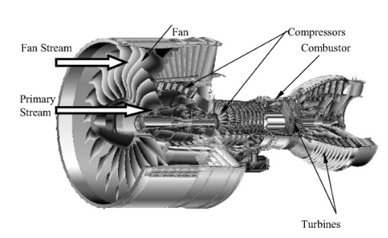
Literature Reviews
IoT has made far-reaching changes in predictive maintenance by perpetual monitoring of critical components. Concurrent data input from IoT sensors such as vibration, pressure readings, temperature helps to provide the foundation of anomaly analysis and fault detection. Observation has been made, that shows low latency data transmission is crucial during continuous jet engine’s health monitoring based on IoT-based frameworks exploration (S. Nasir et al, 2022). The challenge is to achieve good performance in extreme operating conditions consistently. IoT-enabled fault detection system has been proposed by the leverages of pressure and vibration sensors and coupled with unsupervised learning models. The feasibility of early stages of fault detection being demonstrates but facing real-time deployment challenges (L. Zhang et al, 2019)
Figure ‎2.1 Turbofan Engine

Slide 8
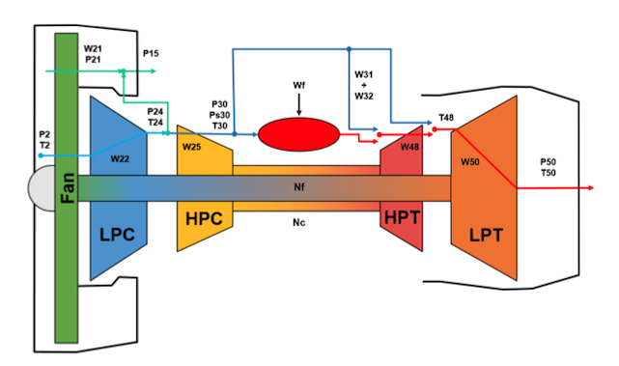
Literature Reviews
High-frequency sensor data collection have its own data processing pipeline by using hybrid IoT-cloud framework. The machine learning models involving fault detection models by applying Random Forest and SVM Big Data Analytics as supervised learning models. These models are focused on data pre-processing for the purpose of handling noise and missing values. Predictive Maintenance in Aircraft Engines (R. Mohanty et al., 2021) The outputs of the system model are estimates of the measured physical properties s and unobserved properties x, that are not part of the condition monitoring signals (i.e., virtual sensors). (Wu Ju et al., 2020)
Figure 2.1 Schematic representation of the CMAPSS model as depicted in the CMAPSS documentation (Frederick et al., 2020)

Slide 9
Literature Review
Title | Author | Finding
Real-Time Monitoring for Predictive Maintenance in Aerospace | S. Nasir et al., 2022) | IoT-Based Data Monitoring; Real-time IoT systems for engine health monitoring
IoT and Big Data Analytics for Aircraft Engines | R. Mohanty et al. 2021) | Big Data and Machine Learning: Success stories on predictive maintenance
Digital Twins for Aircraft Engine Health | (P. Li et al. 2020) | Digital Twin Technology :Virtual replicas for operational optimization
Fault Diagnosis Using IoT-Based Sensors | (L. Zhang et al., 2019) | Fault Detection and Diagnostics: Innovative fault detection algorithms leveraging IoT.

Slide 10
Literature Review
Title | Author | Finding
Real-Time IoT Data Processing for Predictive Maintenance in Aerospace Applications | (D. Lee et al. 2018) | IoT and Cloud Platforms: Framework for cloud-based predictive systems.

Slide 11
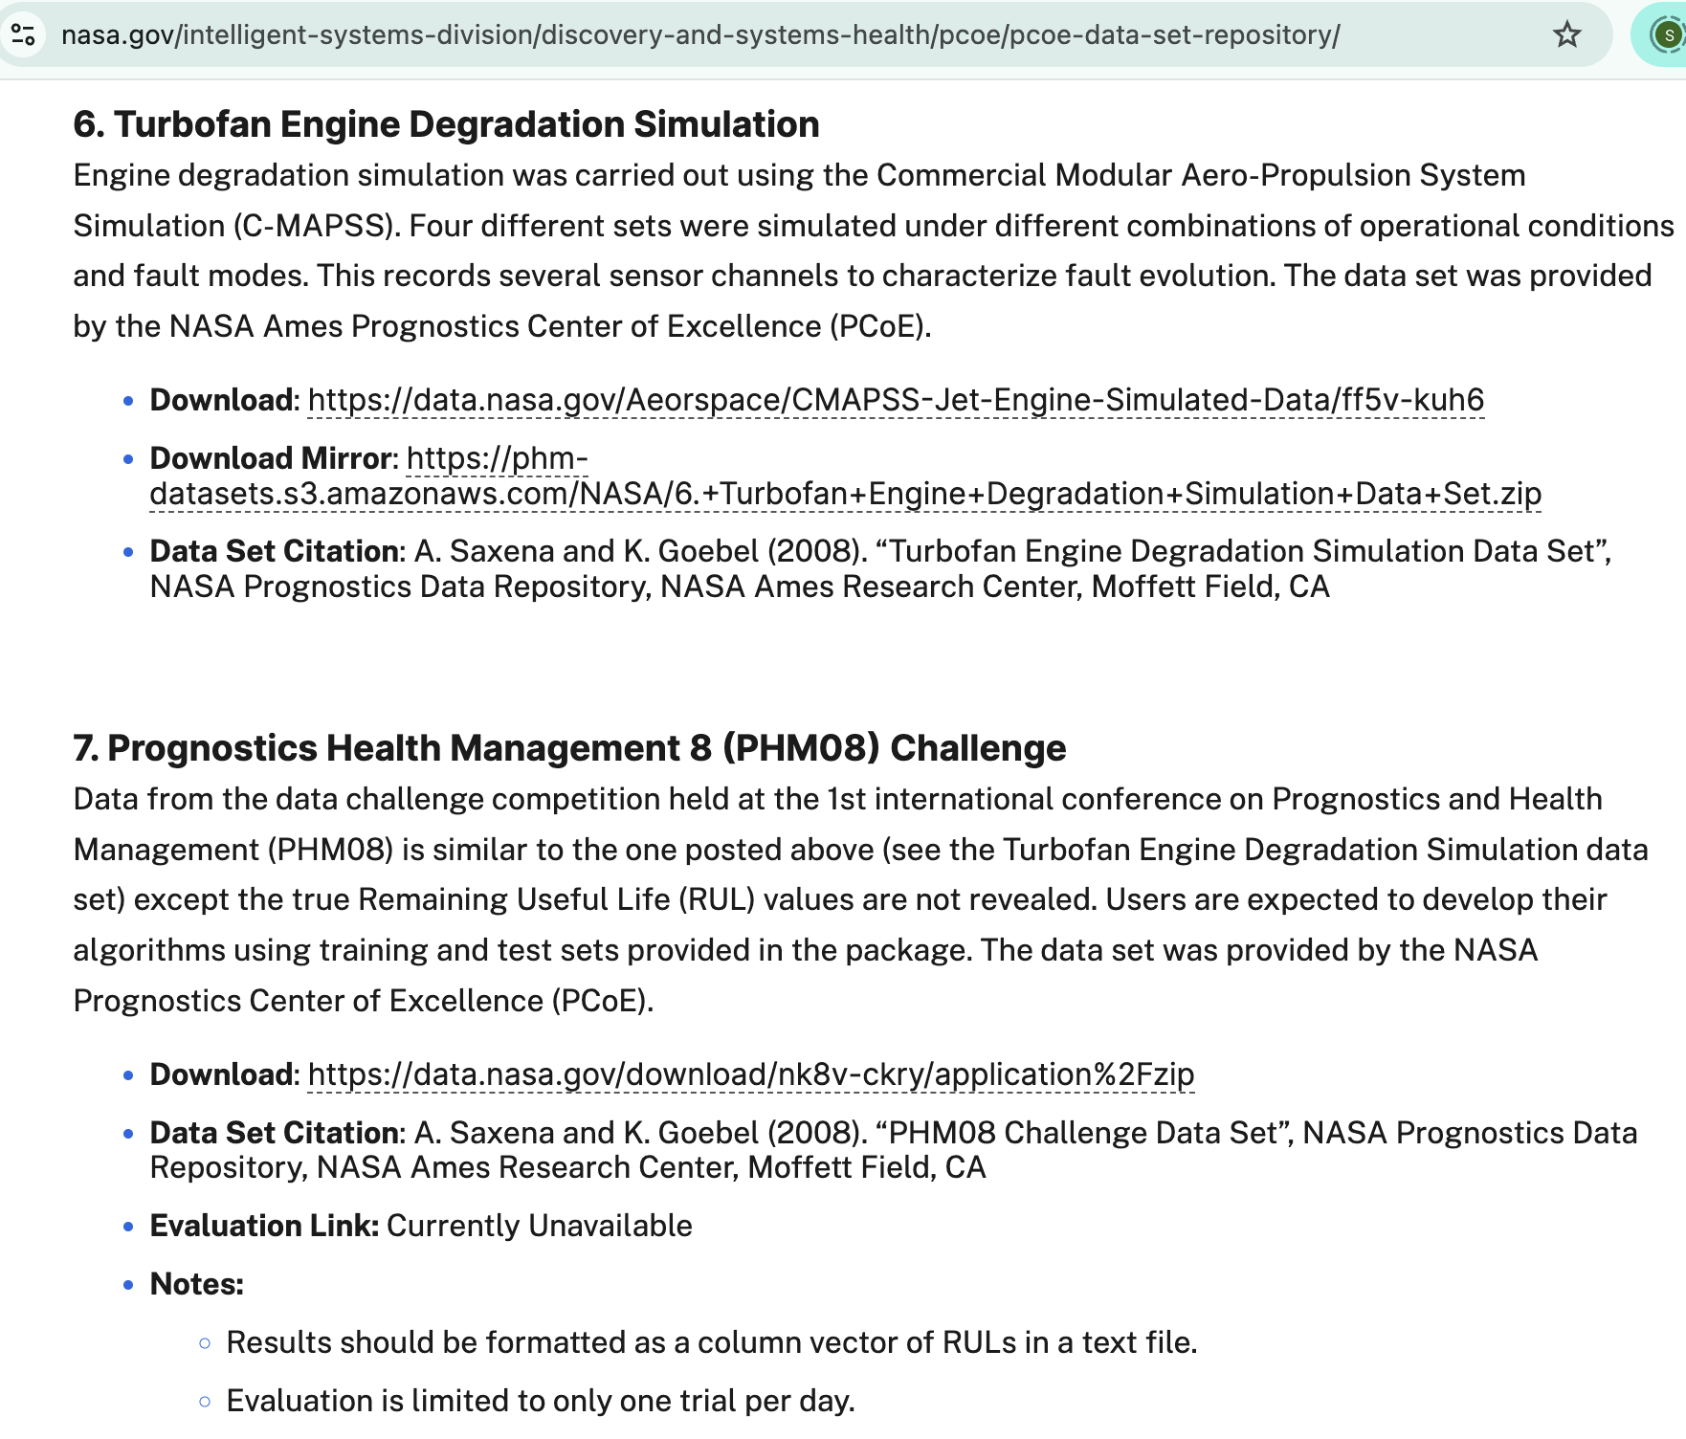
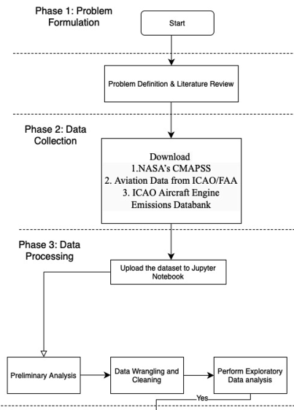
Research Methodology
Data Collection
Figure ‎3.2 Review Dataset
Figure ‎3.2 Research framework Phase 1-3

Slide 12
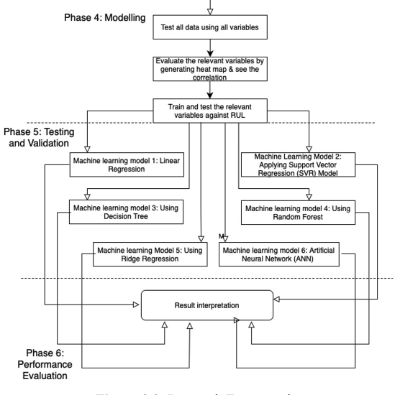
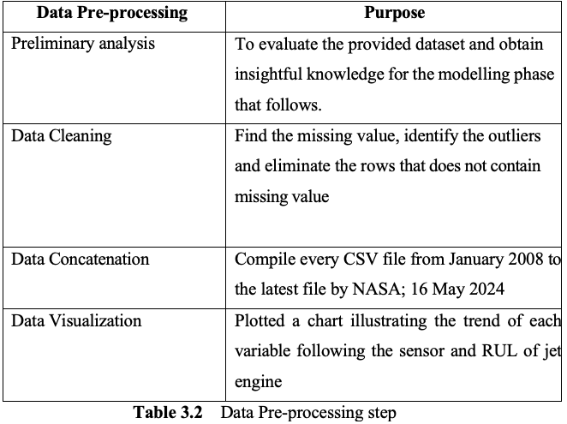
Research Methodology
Data Preprocessing and Exploratory Data Analysis
Data Cleaning
Remove any rows with missing product review data or ratings.
Replace missinremove the rows, as there's a large dataset.
Preprocess text by:
Converting to lowercase
Removing extra whitespaces
Replacing digits and punctuation with spaces
Eliminating extra spaces and tabs
Tokenize the text into words or sub-words standardization.
Figure ‎3.2 Research Framwork Phase 4-6

Slide 13
Research Methodology
Exploratory Data Analysis
Building Model
Model 1: Linear Regression
Model 2: Applying Support Vector Regression (SVR) Model
Model 3: Using Decision Tree
Model 4: Using Random Forest
Model 5: Using Ridge Regression
Model 6: Neural Network Model
Figure ‎3.2 Research Framwork Phase 4-6

Slide 14
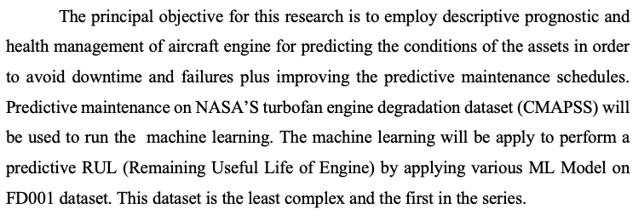
Research Methodology
CMAPPS
Predictive maintenance on NASA’s turbofan engine degradation dataset (CMAPSS) are selected to assist in achieving the objectives. The data is obtained from official website of NASA’s Open Source Data. Dataset FD001 contains :
Train trajectories: 100 engines.
Test trajectories: 100 engines.
Fault Modes: ONE.
Datasets consist of simulations from multiple turbofan engines over period of time, each row contains the following information:
Engine unit number
Time, in cycles
Three operational settings
Readings from 21 sensors

Slide 15
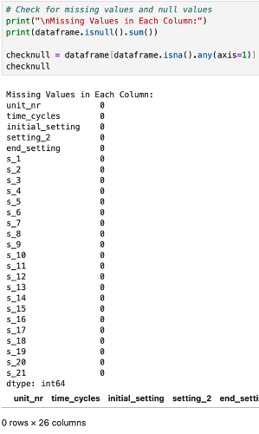
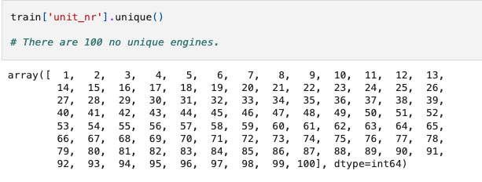
Figure below shows the dataset information for the 21 sensors and 100 units of engine .
Exploratory Data Analysis
Figure ‎4.6 Data Information

Slide 16
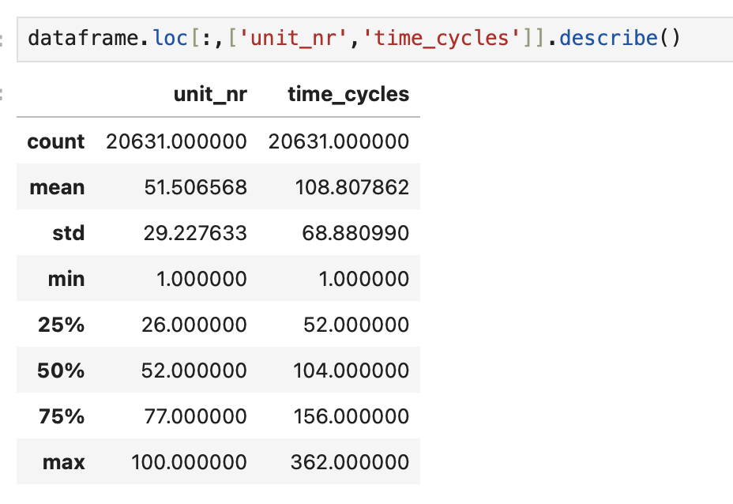
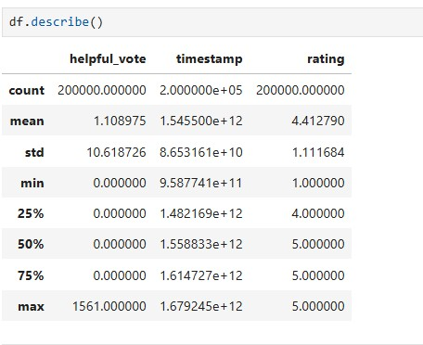
In figure 3.6 shows the dataset description which is about the basic statistical analysis such as mean, standard deviation, minimum and maximum values. Data count is 20630
Exploratory Data Analysis
Figure ‎3.6 Dataset Description

Slide 17
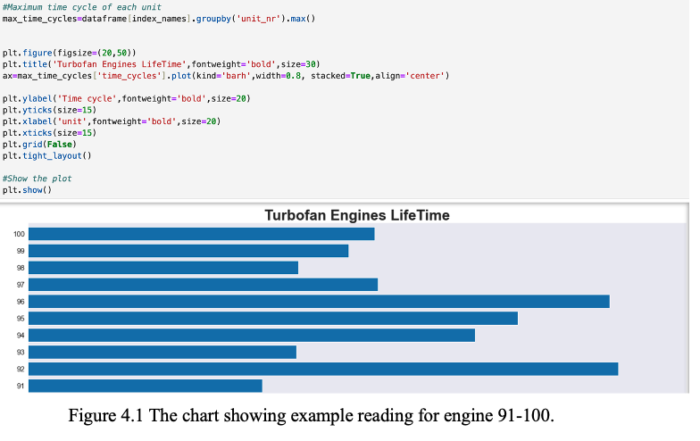
100 units of jet engine actual RUL plotted
Exploratory Data Analysis
Figure ‎4.5 World Cloud of Positive Sentiment

Slide 18
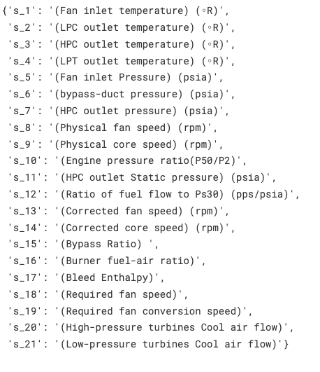
The 21 sensor dictionaries
Exploratory Data Analysis

Slide 19
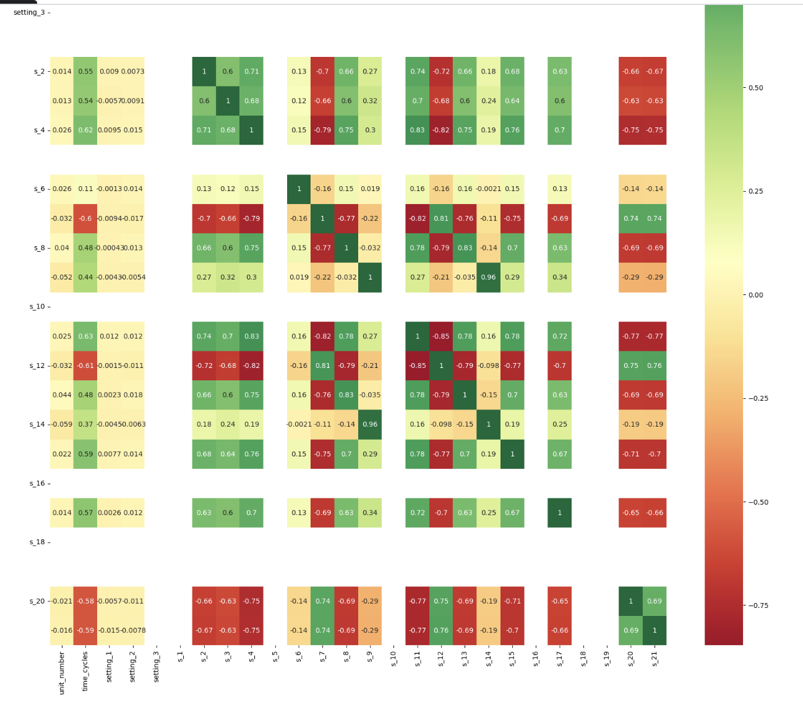


Heatmap being used to show correlation between sensor features & RUL. Darker colours act as indicator of low intensity regions hence the correlation between sensors reading and RUL is weaker, meaning the sensors are less significant in RUL prediction.
Exploratory Data Analysis
Figure ‎4.7 World Cloud of Neutral Sentiment

Slide 20
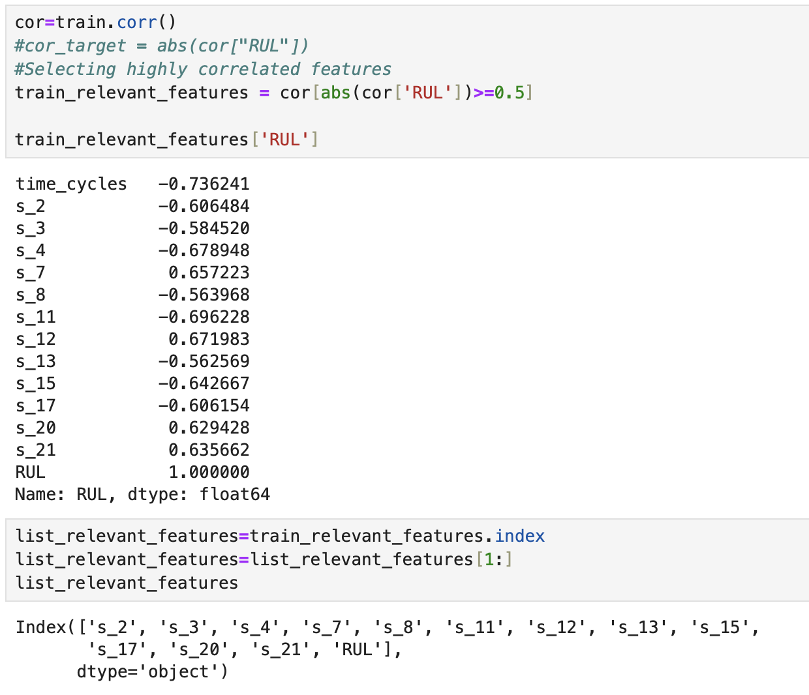
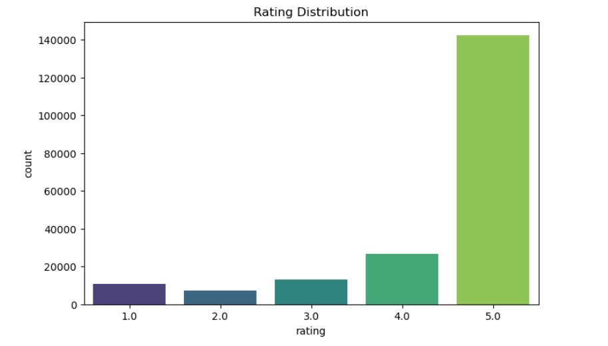
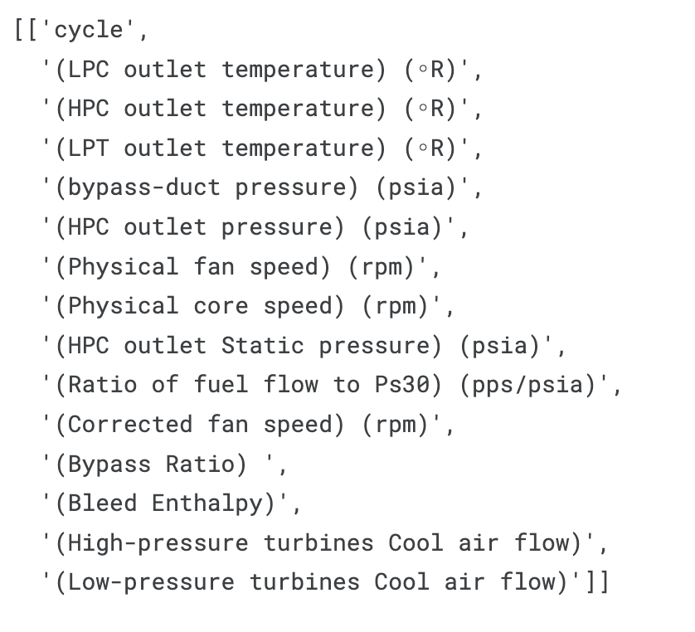
Relevant sensor that indicate features and only sensor below will be used to train and test to predict the Remaining Unit Life (RUL) of 100 engines
Exploratory Data Analysis
Figure ‎4.8 Rating Distribution

Slide 21
Only use Model 1 and Model 2 as machine learning model for proposal. Other 4 model will be used later on during Project 1.
Model 1: Linear Regression
Model 2: Applying Support Vector Regression (SVR) Model
Model 3: Using Decision Tree
Model 4: Using Random Forest
Model 5: Using Ridge Regression
Model 6: Neural Network Model
Exploratory Data Analysis
Figure ‎4.9 Verifies Purchase Distribution

Slide 22
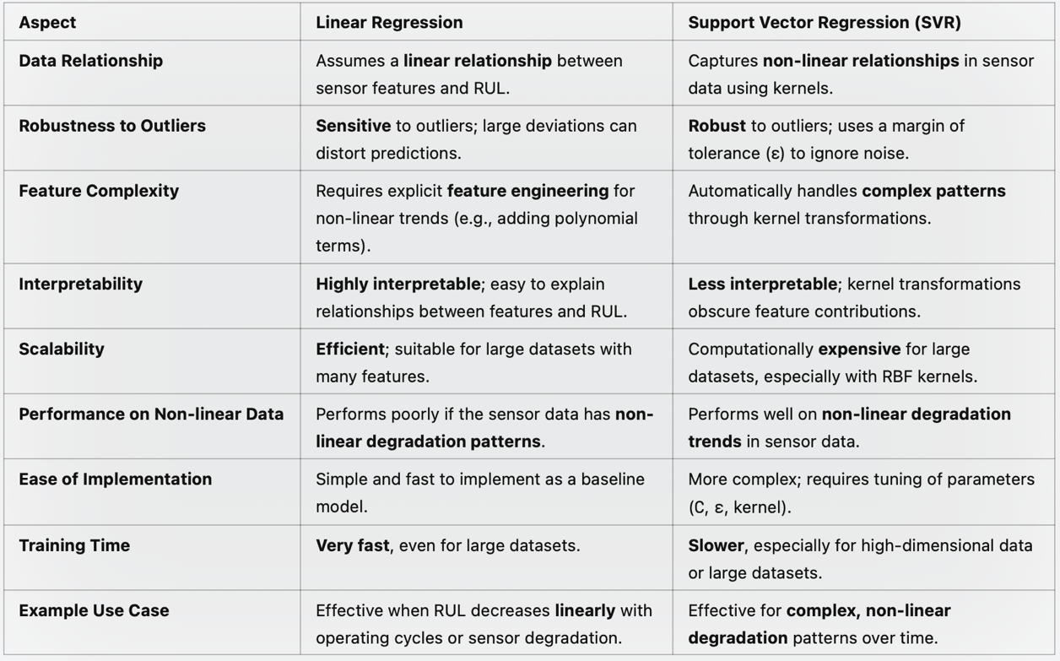
Comparison between Linear Regression and Support Vector Regression (SVR)
Model Development
Figure ‎4.15 Data Frame of VADER Model

Slide 23
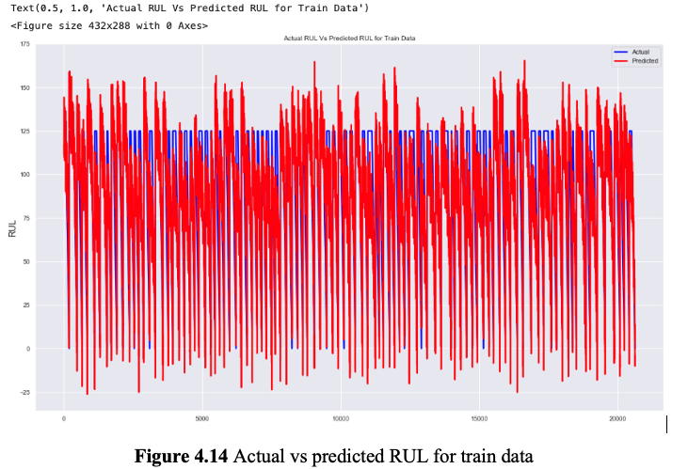
After training and test, actual versus predicted graph are plotted as a comparison to see if Linear regression model are capable to show the predicted trend (red graph) related to the actual RUL (blue graph) test data showing RMSE = 22.9 while R2 score = 0.695
Exploratory Data Analysis
Linear Regression model

Slide 24
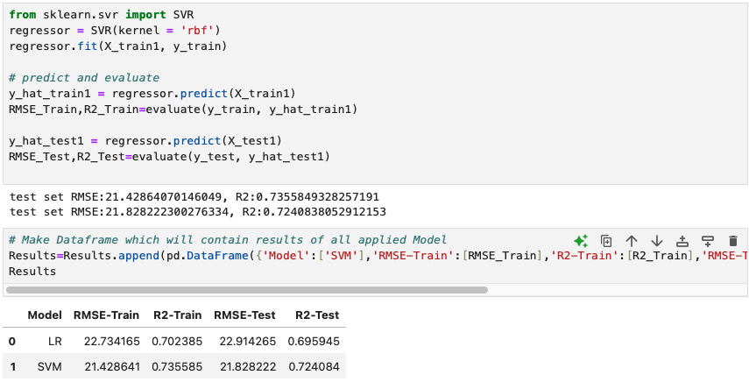
The RMSE Result for test and train model has been increased after applying SVR model. The value now is lower than Linear regression models meaning magnitude of error made by prediction model has become smaller hence the result are more accurate.
Exploratory Data Analysis
Figure ‎4.16 Applying SVR to the dataset

Slide 25
Achievements for this research are:
Do the predictive modelling based on method used by TotalCare program by Rolls Royce engine manufacturer.
EDA has been done properly
Root mean square error RMSE has become smaller after machine learning hence the RUL are more accurate
Model Linear regression and Support Vector Regression (SVR) has done and result being compared with actual RUL
Discussion and Future Work
Future Work in this project
Use engine emissions databank from Aviation data and IoT simulated sensor dataset hence these data shall undergo phase 3 to 6 dataset to explore more about the validation purpose involving testing fault detection performance by using simulated engine data.
Do with other 4 models at least 5-10 times repetition for each model to get more accurate RUL pattern
Visualization of the useful insights from the machine learning model by using interactive dashboard

Slide 26
Nasir, S., Zainab, H., & Hussain, H. K. (2022). Real-Time Monitoring for
Predictive Maintenance in Aerospace.
Mohanty, R., Ramasamy, A. K., & Mohanty, A. (2021). IoT and Big Data Analytics for Predictive Maintenance in Aircraft Engines. Zhang, L., Wang, Y., & Zhao, X. (2019). Fault Diagnosis in Jet Engines Using IoT- Based Sensors.
Li, P., Chen, T., & Xiang, J. (2020). Digital Twins for Aircraft Engine Health Monitoring.
Herceg, M., Raff, T., Findeisen, R., & ... (2006). Nonlinear model predictive control of a turbocharged diesel engine. 2006 IEEE Conference …, Query date: 2024-12-12 14:04:27. https://ieeexplore.ieee.org/abstract/document/4777076/
References

Slide 27
Jafari, S., & Nikolaidis, T. (2019). Meta-heuristic global optimization algorithms for aircraft engines modelling and controller design; A review, research challenges, and exploring the future. Progress in Aerospace Sciences, Query date: 2024-12-12 14:11:01. https://www.sciencedirect.com/science/article/pii/S0376042118301416
https://data.nasa.gov/Aerospace/CMAPSS-Jet-Engine-Simulated-Data/ff5v-kuh6/about_data A. Saxena, K. Goebel, D. Simon, and N. Eklund, ‘Damage Propagation Modeling for Aircraft Engine Run-to-Failure Simulation’, in the Proceedings of the 1st International Conference on Prognostics and Health Management (PHM08), Denver CO, Oct 2008.
https://www.nasa.gov/intelligent-systems-division/#turbofan
References

Slide 28
https://www.easa.europa.eu/en/domains/environment/icao-aircraft-engine-emissions-databank?utm_source=chatgpt.com
https://archive.ics.uci.edu/dataset/601/ai4i+2020+predictive+maintenance+dataset
Wu, J.; Hu, K.; Cheng, Y.; Zhu, H.; Shao, X.; Wang, Y. Data-driven remaining useful life prediction via multiple sensor signals and deep long short-term memory neural network. ISA Trans. 2020, 97, 241-250.
References

Slide 29


THANK YOU
utmofficial
univteknologimalaysia
utm.my

